Slide 1
Programming Fundamentals
By
Shazmeen Batool

Slide 2
Previous Lecture
Introduction to pointers

Slide 3
Today’s Lecture
Relationship Between Array and Pointers
Pointer Arithmetic

Slide 4
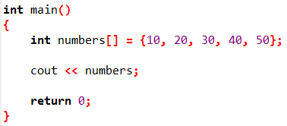

The Relationship Between Arrays and Pointers
Array names can be used as constant pointers, and pointers can be used as array names.
As you know array name, without brackets and a subscript, actually represents the starting address of the array. This means that an array name is really a pointer.

Slide 5
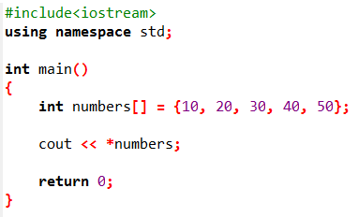

This program shows an array name being dereferenced with the * operator.
Because numbers works like a pointer to the starting address of the array, the first element is retrieved when numbers is dereferenced.

Slide 6
The Relationship Between Arrays and Pointers
So how could the entire contents of an array be retrieved using the indirection operator?
Now, here's the key idea: When you want to get to another box, you can use either:
Subscript notation (like numbers[1] to get Box 1).
Pointer notation (like *(numbers + 1) to get the same Box 1).
Pointers don't work like regular numbers. If you add 1 to a regular number (like 5 + 1 = 6), it's just adding 1. With pointers, adding 1 actually moves the arrow by the size of one box.

Slide 7
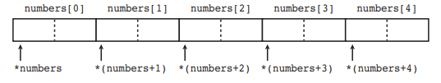
The Relationship Between Arrays and Pointers
This "jump" happens automatically in C++ because the computer knows the size of the data type (here, 4 bytes for int).
*(numbers + 0) is the same as numbers[0] (first box).
*(numbers + 1) is the same as numbers[1] (second box).
*(numbers + 2) is the same as numbers[2] (third box).

Slide 8
The Relationship Between Arrays and Pointers
The parentheses are critical when adding values to pointers.
The * operator has precedence over the + operator, so the expression *number + 1 is not equivalent to *(number + 1).
*number + 1 adds one to the contents of the first element of the array, while *(number + 1) adds one to the address in number, then dereferences it.

Slide 9
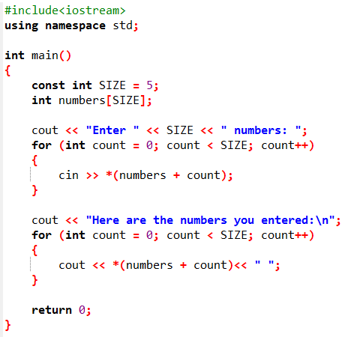
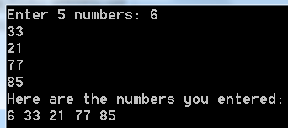
This program processes an array using pointer notation.

Slide 10
The Relationship Between Arrays and Pointers
Address operator(&) is not needed when an array’s address is assigned to a pointer. Because the name of an array is already an address, use of the & operator would be incorrect.
You can, however, use the address operator to get the address of an individual element in an array. For instance, &numbers[1] gets the address of numbers[1].

Slide 11
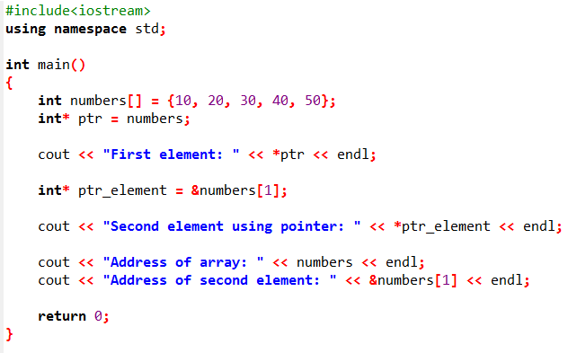

Example

Slide 12


The Relationship Between Arrays and Pointers
int arr[4] = {11,13,15,18};
int *ptr = arr
int *p1 = &arr[2];

Slide 13
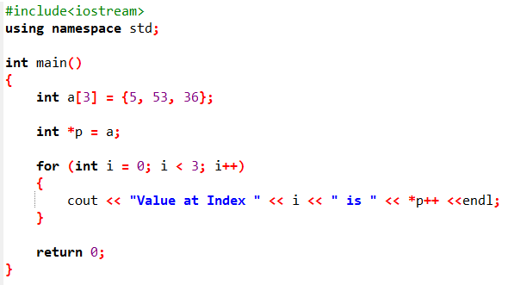

Pointer Arithmetic
Some mathematical operations may be performed on pointers.

Slide 14
Task
Write a code to print an array in a reverse order using pointers.

Slide 15
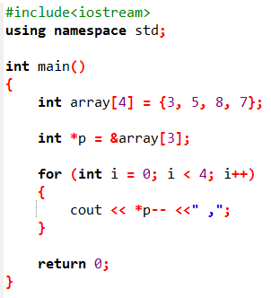


Slide 16
Pointer Arithmetic
Not all arithmetic operations may be performed on pointers. For example, you cannot multiply or divide a pointer.
The following operations are allowable:
The ++ and −− operators may be used to increment or decrement a pointer variable.
An integer may be added to or subtracted from a pointer variable. This may be performed with the + and − operators, or the += and −= operators.
A pointer may be subtracted from another pointer.

Slide 17
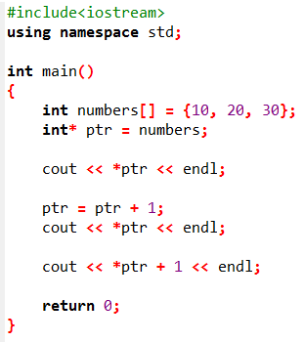

What is the output?

Slide 18
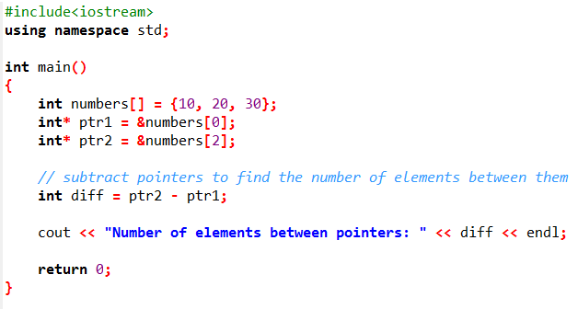
What is the output?

Slide 19


Initializing Pointers
Pointers may be initialized with the address of an existing object.
Following are the legal definitions:

Slide 20

Initializing Pointers
The following is illegal because pint is being initialized with the address of an object that does not exist yet:

Slide 21
Class Activity
Assume pint is a pointer variable. Is each of the following statements valid or invalid? If any is invalid, why?
pint++;
Valid.
--pint;
Valid.
pint /= 2;
Invalid.
Division assignment (/=) is not defined for pointers in C++. You cannot divide a pointer by an integer.

Slide 22
Class Activity
Assume pint is a pointer variable. Is each of the following statements valid or invalid? If any is invalid, why?
pint *= 4;
Invalid.
Multiplication assignment (*=) is also not defined for pointers. You cannot multiply a pointer by an integer.
pint += x; (where x is an int)
Valid.

Slide 23
Class Activity
Is each of the following definitions valid or invalid? If any is invalid, why?
int ivar;
int *iptr = &ivar;
Valid.
int ivar, *iptr = &ivar;
Valid.
float fvar;
int *iptr = &fvar;
Invalid.
Assigning float* to int* is invalid because they are incompatible pointer types.

Slide 24
Class Activity
Is each of the following definitions valid or invalid? If any is invalid, why?
int nums[50], *iptr = nums;
Valid.
int *iptr = &ivar;
int ivar;
Invalid.
You can't take the address of a variable that hasn't been declared yet. The compiler needs to see int ivar; before you use &ivar.

Slide 25
Next Lecture
Reference Variable
Double Pointers
Dynamic memory Allocation

